Slide 1
TRAVEL WEBSITE PRADYUMAN PRATAP SINGH 2017-301-125 Dr. Samar Wazir

Slide 2
OBJECTIVE
Aim of this project is to provide a static website. This static websites allows businesses to explain their company's goals and objectives. The main purpose of our static website designing services it to provide you with an online presence. This would help you to showcase your products and earn business.

Slide 3
INTRODUCTION
INTRODUCTION TO MY WEBSITE
Basically I have created a static website which is related to travelling. This website shows different places to visit and some featured destinations (whose rating is quite good) with their travelling plans which are worthy and exciting according to customers. And there is a travelling gallery which has photos of different places.

Slide 4
PROBLEM STATEMENT
The traditional tourism distribution channel faces a threat of the emerging IT
environment. Throughout years the travel industry was dependent on the intermediaries, who
enabled the interaction between the suppliers and the customers.
The internet allows a wide range of benefits for the companies and the customers, making the
information widely available, reducing the difficulties in purchasing, marketing and distribution,
allowing the sellers and the buyers to direct transact with each other.

Slide 5
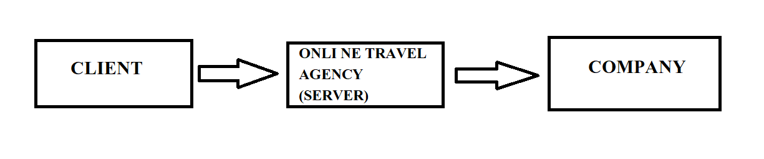
LEVEL 1 DFD

Slide 6
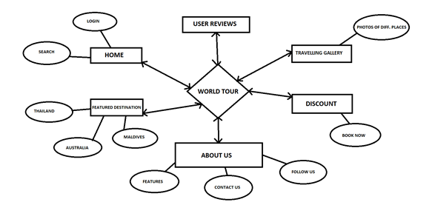
ER DIAGRAM

Slide 7
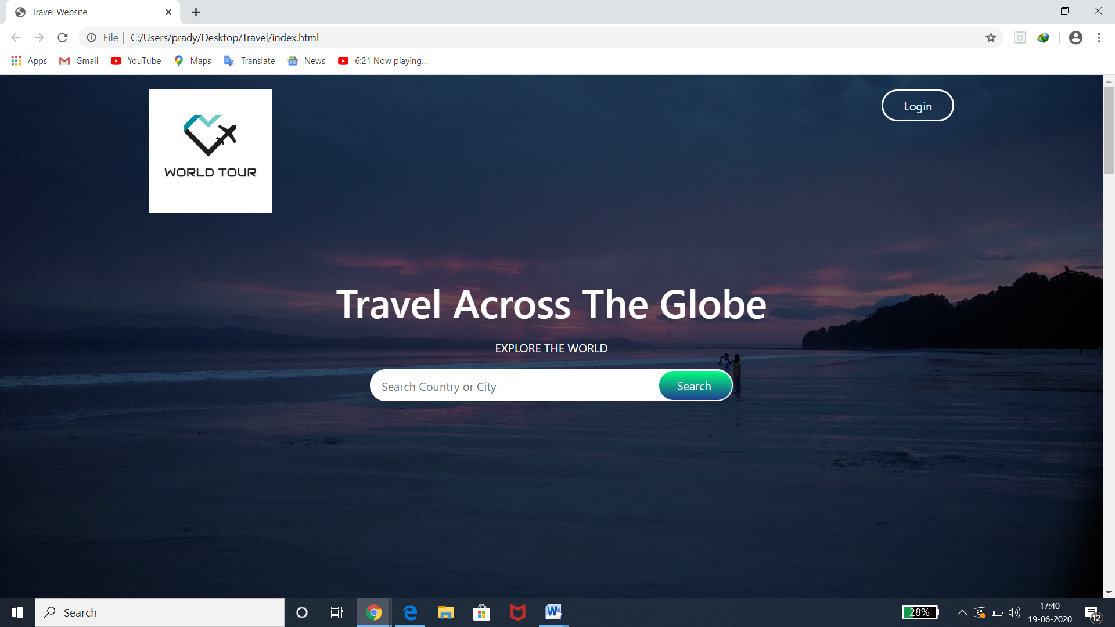
SNAPSHOTS

Slide 8
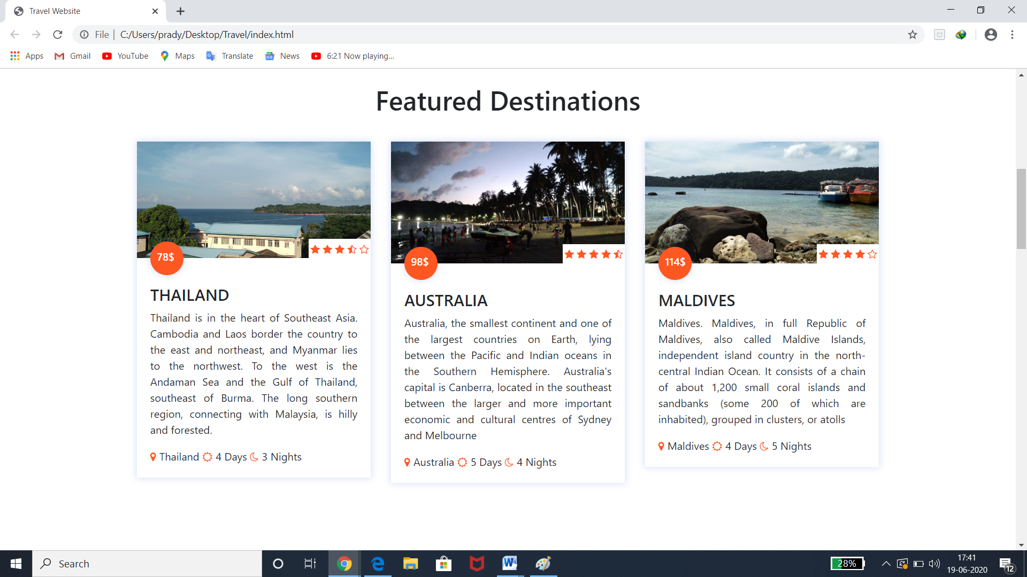

Slide 9
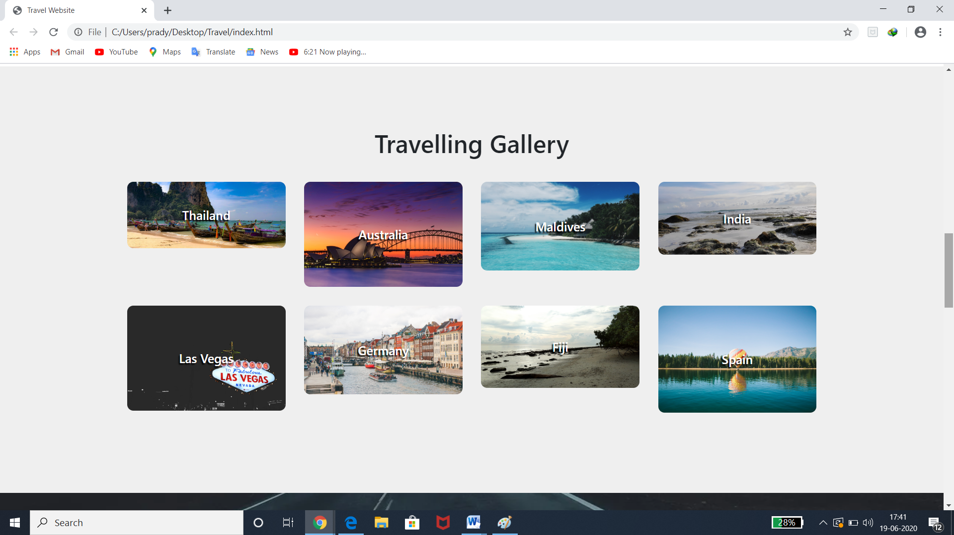

Slide 10
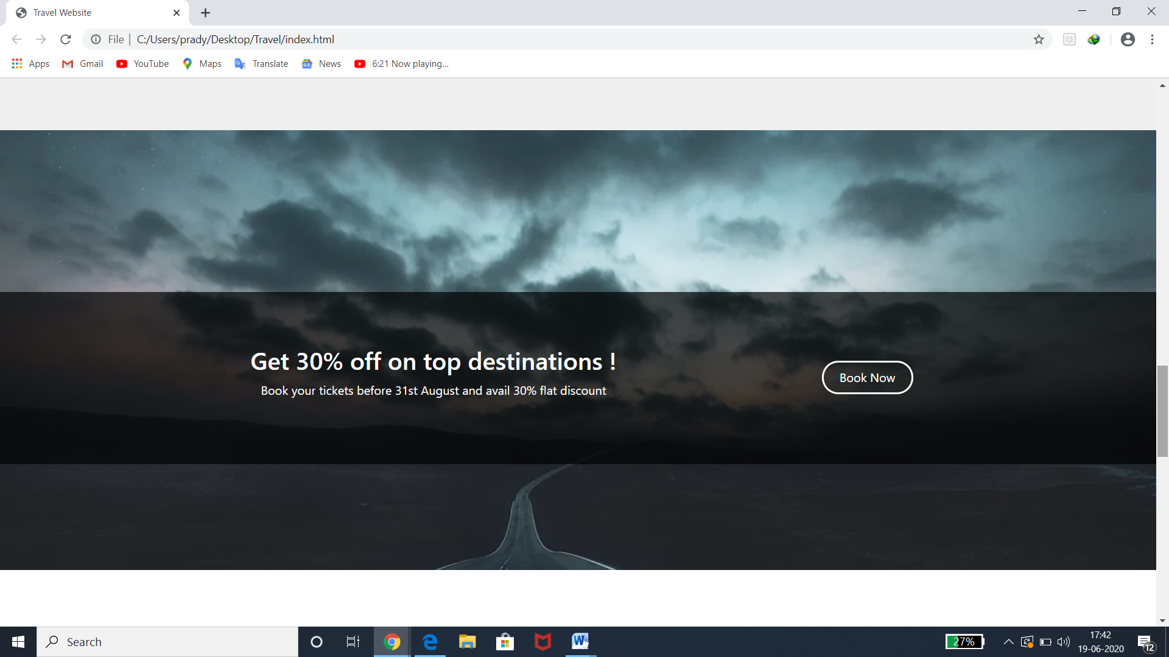

Slide 11
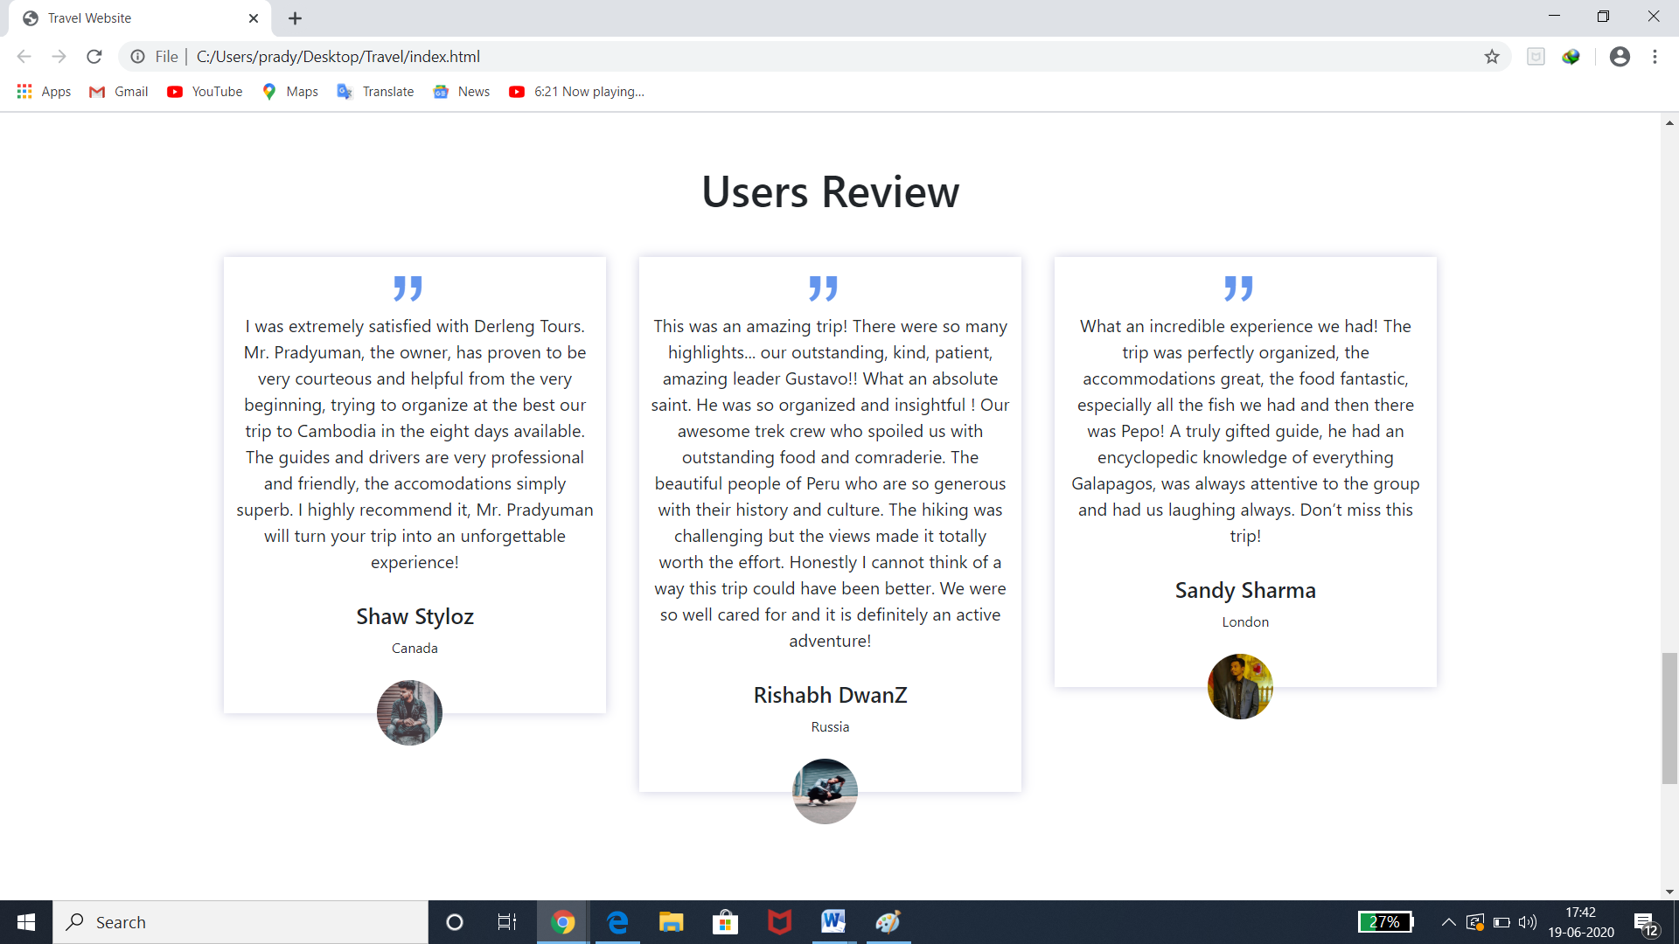

Slide 12
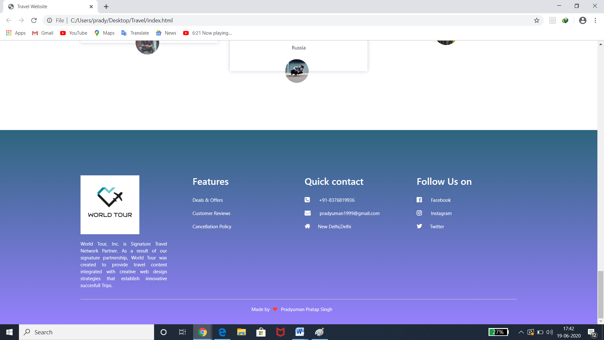

Slide 13
CONCLUSION
This project will help the Travelling firm to promote their business online and gain more user as well as help the users to directly access the widely available information.

Slide 14
LIMITATIONS AND FUTURE SCOPE
LIMITATIONS
• Internet Reliance – The one flaw with the internet is it is not everywhere yet. If your internet goes down or you happen to be in an area that has not been connected yet you will not be able to access your web app.
• Security – There is no denying that your data is less secure when it’s in the cloud, especially when users from all over the world are accessing the same server hosted by a third party. Although there are ways to reduce your risk, email encryption and SSL enforcement for secure HTTPS access are just two examples.
• Reduced speed – A web app will probably be slower than an application hosted on your company’s server. You need to decide if a slight reduction in speed is worth the worldwide access.
• Browser Support – Unfortunately, we do not all use one version of a browser because we are given a choice. This means you will have to make sure your web app is supported across various browsers and for various screen sizes.

Slide 15
FUTURE SCOPE
There has been a huge increase in the number of websites that are being created. More and more clients are feeling the need for an online presence for their need. The future is ripe for web development as a field and if you are planning to make a career in it, now's the time.

Slide 16
BIBLIOGRAPHY
https://www.wikipedia.org
https://www.tutorialspoint.com
https://www.geeksforgeeks.org
https://www.bootstrapcdn.com
https://www.youtube.com

